Slide 1

Backtracking
K. Rajesh Rao
Asst. Professor- Senior
Dept. of ICT, MIT, Manipal

Slide 2
Contents
Basics
0/1 Knapsack
Max Clique
Travelling Salesperson Problem (TSP)

Slide 3
Basics
Solution space
Data structure used
Live node
E-node (expansion node)

Slide 4
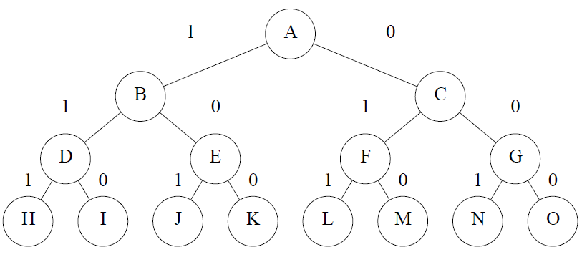
Solution space

Slide 5
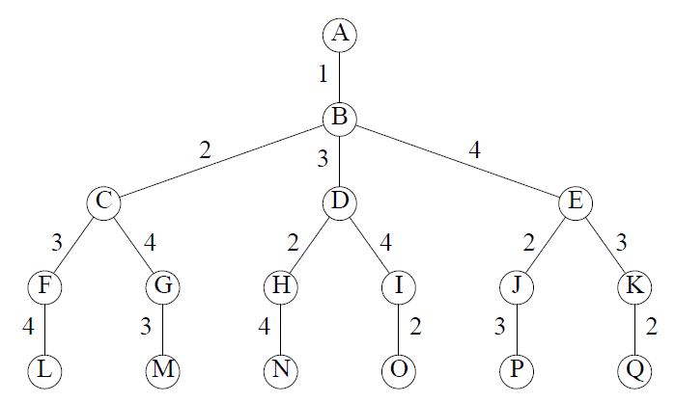
Solution space

Slide 6
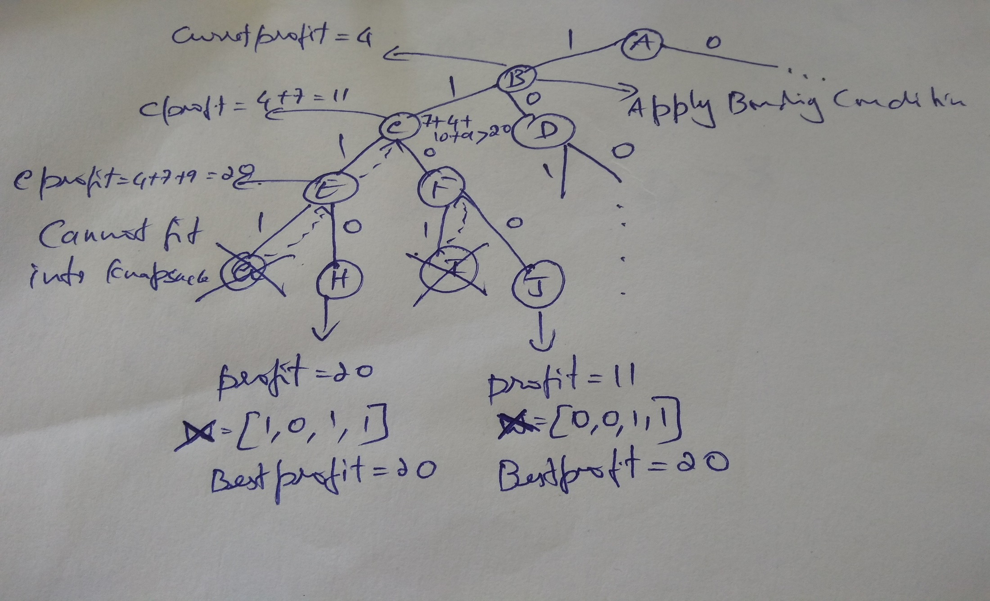
0/1 Knapsack- Example
C=7, P=[9,10,7,4], w=[3,5,2,1] Profit density=[3,2,3.5,4]

Slide 7
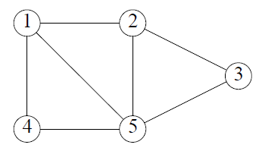
Max Clique
Clique
Max clique

Slide 8
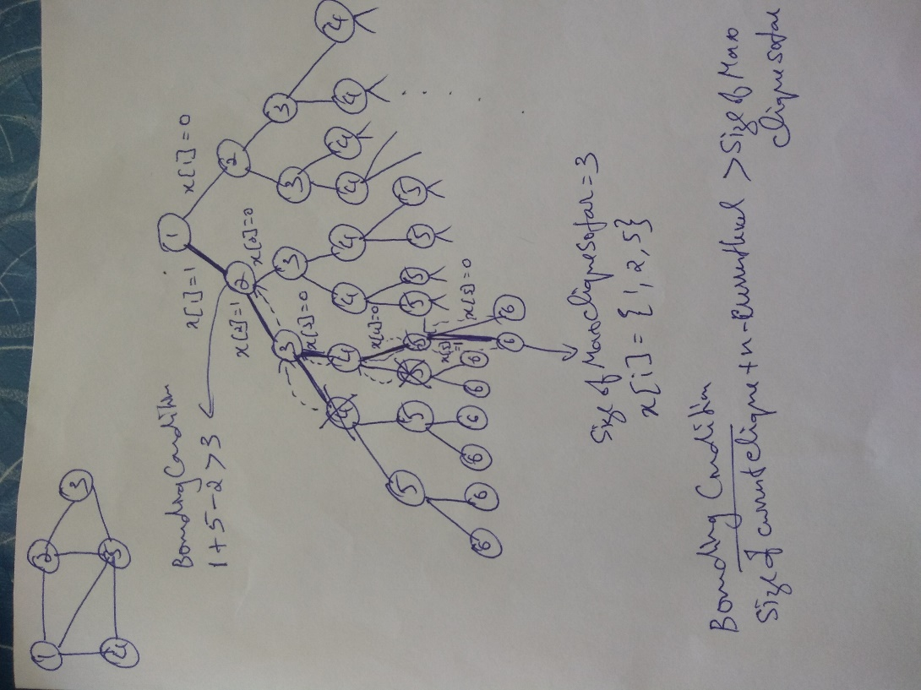
Max Clique- Example

Slide 9
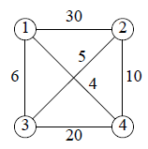
Traveling Salesperson Problem
Problem description
Bounding function
Example
A four vertex network
Solution space tree for a four vertex network

Slide 10
Traveling Salesperson Problem
A four vertex network
Solution space tree for a four vertex network

Slide 11
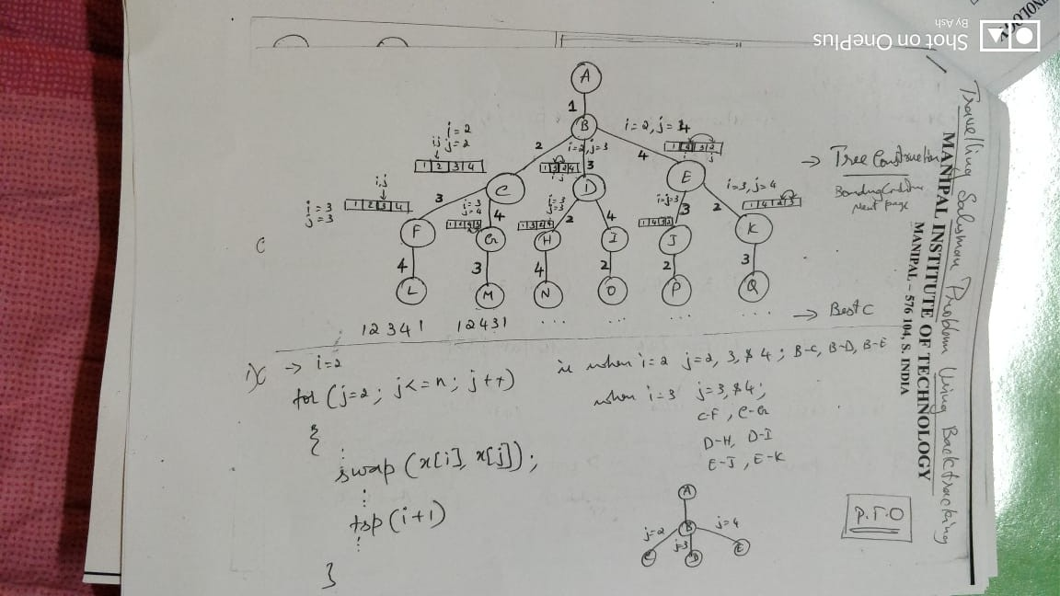
Traveling Salesperson Problem

Slide 12
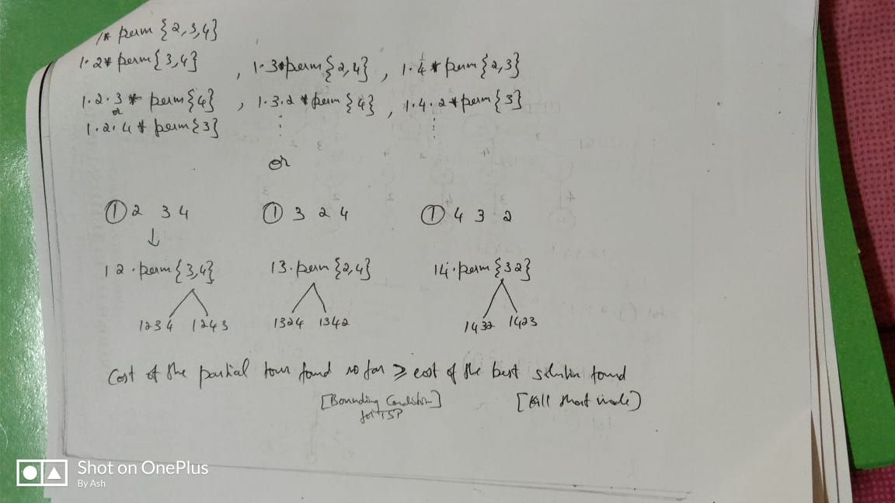
Traveling Salesperson Problem

